Slide 1

Welcome to Austin 78702 or 78745
Austin Matthew Steven Theresa

Slide 2
Motivation & Summary Slide
We are all interested in Real Estate. Our project will determine whether a home purchase within two Austin area codes would be a more profitable investment with estimated growth by the year 2024. We will use the two zip codes of 78702 and 78745 to evaluate the data for east and south Austin, respectively. Concurrently, we will also examine several factors which can influence a home’s value, such as; the crime rate in the area over a given year, the yearly rating of schools in the zip code, the average price per square foot of the homes, and other related factors, as the data permits. We predict that homes in the 78745 zip code (Southern Austin) area will be more profitable by 2024 than homes in the 78702 zip code (Eastern Austin) area.

Slide 3


Questions & Data

Slide 4

Data Cleanup and Exploration

Slide 5
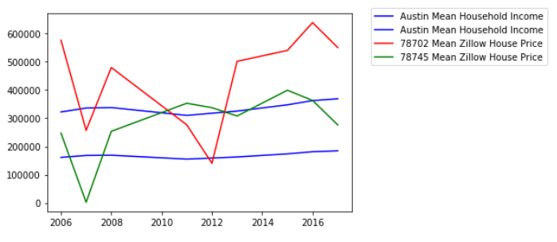

Slide 6
Discussion

Slide 7
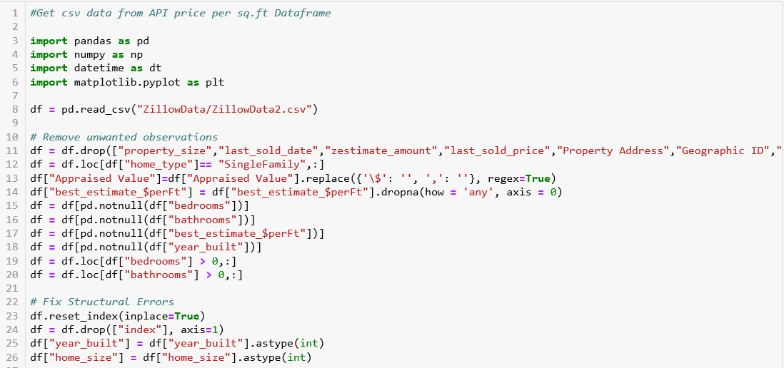
Discussion

Slide 8
Discussion

Slide 9
Discussion

Slide 10
Discussion

Slide 11
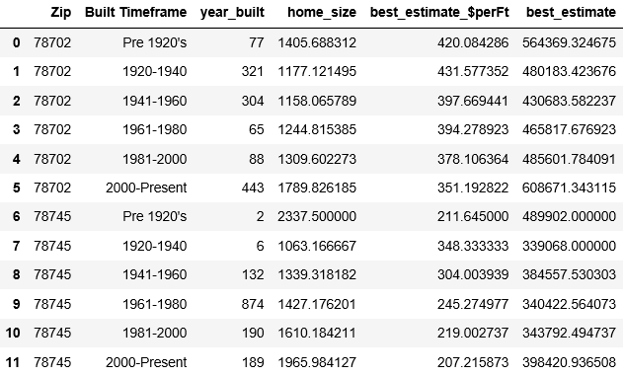
Discussion

Slide 12
Discussion

Slide 13
Post Mortem
Population and Demographics would give us better understanding of population booms we found

Slide 14

Questions

